Slide 1
Towards a Collision Free Medium Access For QoS Support in WLAN
Prepared By
Muhaimenul Islam (134414) Fahmid Shahriar (134419)
Supervised By
Ashraful Alam Khan
Assistant Professor
Islamic University of Technology

Slide 2
Outline
Introduction
EDCA Background
Problem
Existing Solution
Our Goal
Solution
Conclusion

Slide 3
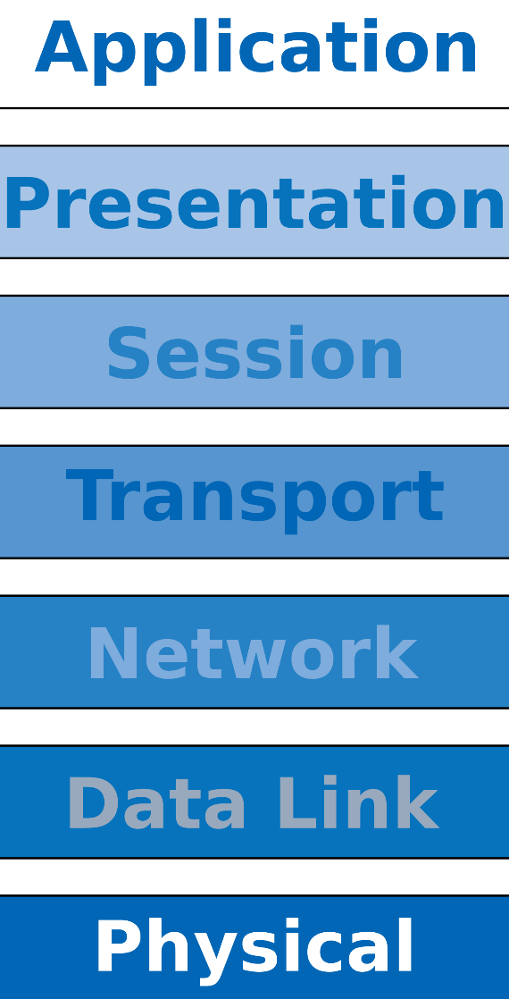
Introduction
Medium access control in WLAN is a great overhead to ensure a better throughput in a wireless medium
Overhead of DIFS and exponential back-off based CW significantly decrease MAC sub-layer efficiency.
New emerging applications requires QoS-constrained traffic at variable rates
Efficient medium access control protocol is necessary to cope up with these challenges.
H
I
G
H
LOW
600 Mbps
HIGH

Slide 4
EDCA Background
Introduction of access categories for the QoS support
Multiple back-off entities with different priorities in parallel
Different AIFS , TXOP, RC for different categories to maintain the priority.

Slide 5
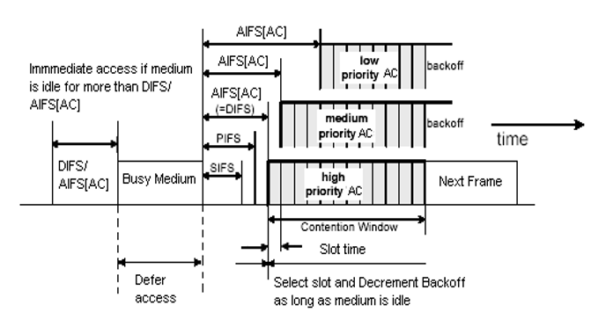
EDCA Background (Cont.)

Slide 6
Problem with EDCA
Different access categories may collide with each other
Lots of idle time
Probability of collision is still high
Channel access mechanism is randomized

Slide 7

Problem with EDCA (Cont.)
4
8
AIFS[H]
DATA
A
5
AIFS[L]
4
8
AIFS[H]
DATA
B
6
AIFS[L]

Slide 8
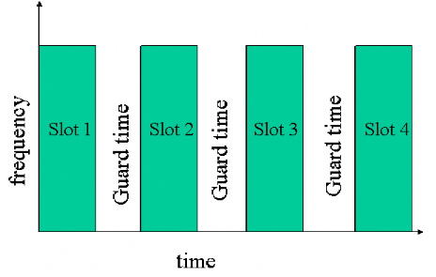
Existing Solutions
Co-ordination based Scheme:
Central coordinator fixed the schedule
Disadvantage:
Single point of failure
Requires extra infrastructure
Slot-assignment scheme: TON_2017 ,[5] [9]
Reserve slots for transmission
Combine TDMA and CSMA approach
Disadvantage:
Global Synchronization needed
Learning and set up phase for scheduling
Vulnerable to slot drifts

Slide 9


Existing Solutions
Multi-frequency assisted schemes
Total frequency is divided into different subcarriers
Each node is assigned with a different subcarrier
Dual Antenna Method [2]
Receiver based Method [1]
Disadvantage:
Costly infrastructure
Limited scalability

Slide 10
Our Goal
Reduce the probability of collision using a effective back-off process
Reduce the idle time
Ensuring priority access
Gain a better convergence speed to steady date
Without-
Centralized support
Additional frequency and hardware Infrastructure

Slide 11
Proposed Solution
Modified deterministic back-off for different access categories
Multiplicative approach for collision
Special retry counter for detecting the congested scenario

Slide 12
Reducing the probability of collision ( Modified Deterministic back-off)
Different access categories will use deterministic back-off value after successful transmission.
The range for the back-off value for different categories will be different.
A station with a deterministic back-off value will never collide with the same genre .

Slide 13
Reducing the probability of collision ( Modified Deterministic back-off) Cont.
0
5
10
15
A
B
C
D
E

Slide 14
Use of multiplicative approach:
To ensure fair and prioritize channel access
In the case of collision , the increase of the deterministic back-off value will be multiplicative to the minimum value chosen from the first success.
So in a non-congested scenario two nodes from different categories with same genre will not collide.
Successful periodical transmission is achieved using the proposed back-off process

Slide 15
Cont.
3
6
12
9
A[H] A[L]
B[H] B[L]
R

Slide 16
Reducing the idle time (Retry Counter)
In a non-congested scenario, deterministic node can collide with the random ones
Unnecessary jump to a greater deterministic back-off value due to collision
The collided node will wait for a sudden limit and use the same deterministic back-off value
After reaching the limit, the deterministic back-off value will be increased using the proposed multiplicative back-off process

Slide 17
Faster convergence to a collision-free schedule
A learning phase from the beginning of the active period.
Try to identify the number of nodes in the collision domain using MAC layer packet format
In a congested scenario, during collision jump to a suitable back-off value for avoiding collision using the learning phase.

Slide 18
Conclusion
Performance measure in NS3 simulator
Comparison between Standard EDCA with Ours method
Effect on Throughput
Effect on Collusion Probability
End to End Delay

Slide 19
Performance Evaluation
11/8/17
19

Slide 20
References
[1] Sheeraz A.Alvi1, Adeel Baig, Kashif Sattar2, “Frequency-Domain Backoff Mechanism for OFDM-Based Wireless LANs” [2016]
[2] Souvik Sen, Romit Roy Choudhury, Srihari Nelakuditi “No Time to Countdown:Migrating Backoff to the Frequency Domain” [2014]
[3] Sanabria-Russo, Luis, et al. "A high efficiency MAC protocol for WLANs: Providing fairness in dense scenarios." IEEE/ACM Transactions on Networking (TON) 25.1 (2017): 492-505.
[4] Haitao Zhao , JiboWei , NurulISarkar , ShengchunHuang “E-MAC: An evolutionary solution for collision avoidance in wireless ad hoc networks” [2016]

Slide 21
References
[5] M. F. Tuysuz · H. A. Mantar, “A Beacon-Based Collision-Free Channel Access Scheme for IEEE 802.11 WLANs” [2015]
[6] George W. Wong and Robert W. Donaldson, “Improving the QoS Performance of EDCF in IEEE 802.11e Wireless LANs”
[7] Yan Zhang, Loukas Lazos, Kai Chen, Bocan Hu, and Swetha Shivaramaiah, “Multi-Channel Medium Access without Control Channels: A Full Duplex MAC Design” IEEE, 2017
[8] Boris Bellalta , Luciano Bononib, affaele Brunoc, Andreas Kassler, ‘‘Next generation IEEE 802.11 Wireless Local Area Networks:Current status, future directions and open challenges” [2015]
[9] “Winning the Lottery: Learning Perfect Coordination with Minimal Feedback” , Globecom 2013 - Wireless Communications Symposium

Slide 22
Thank You

